Slide 1
SPIRENT Test Center Set UP
DUT: AMD3151
(Two LAN Loop)

Slide 2
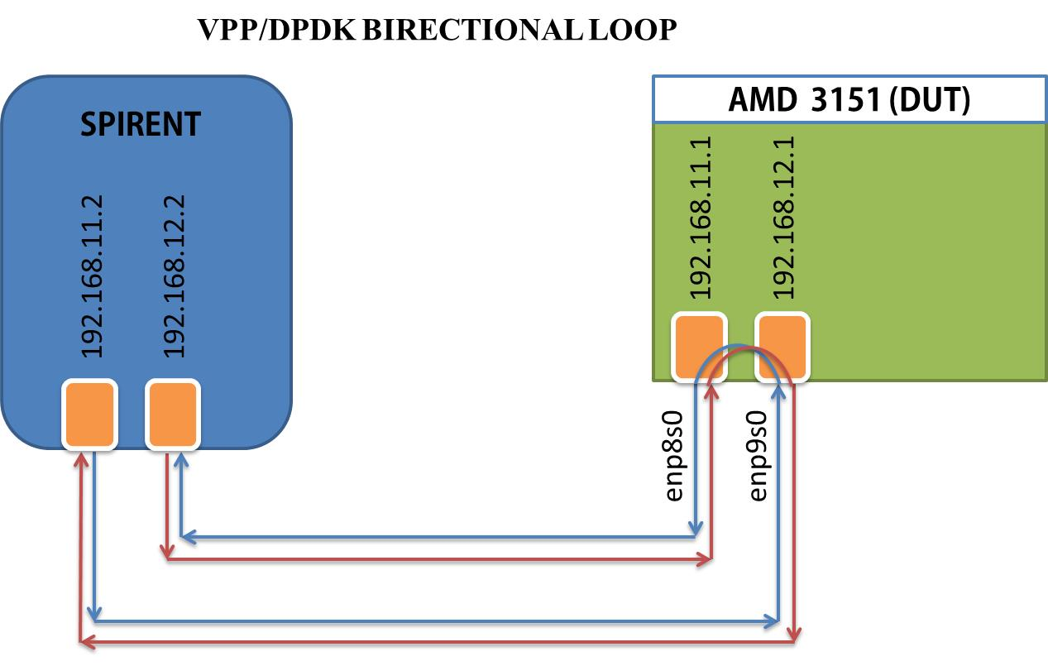
Overview Layout

Slide 3
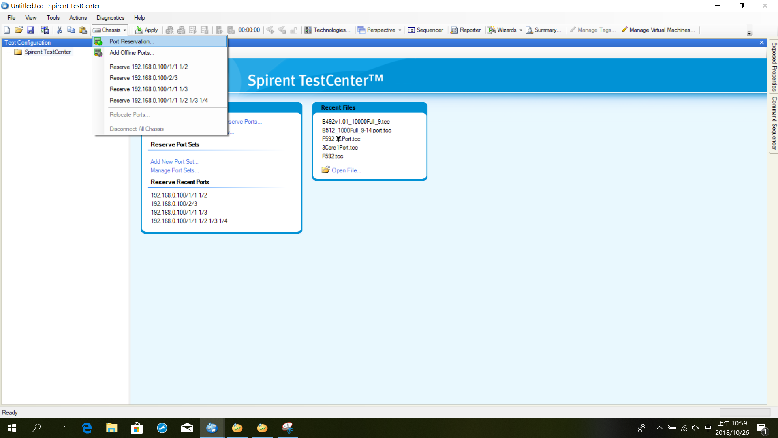
Add Ports

Slide 4
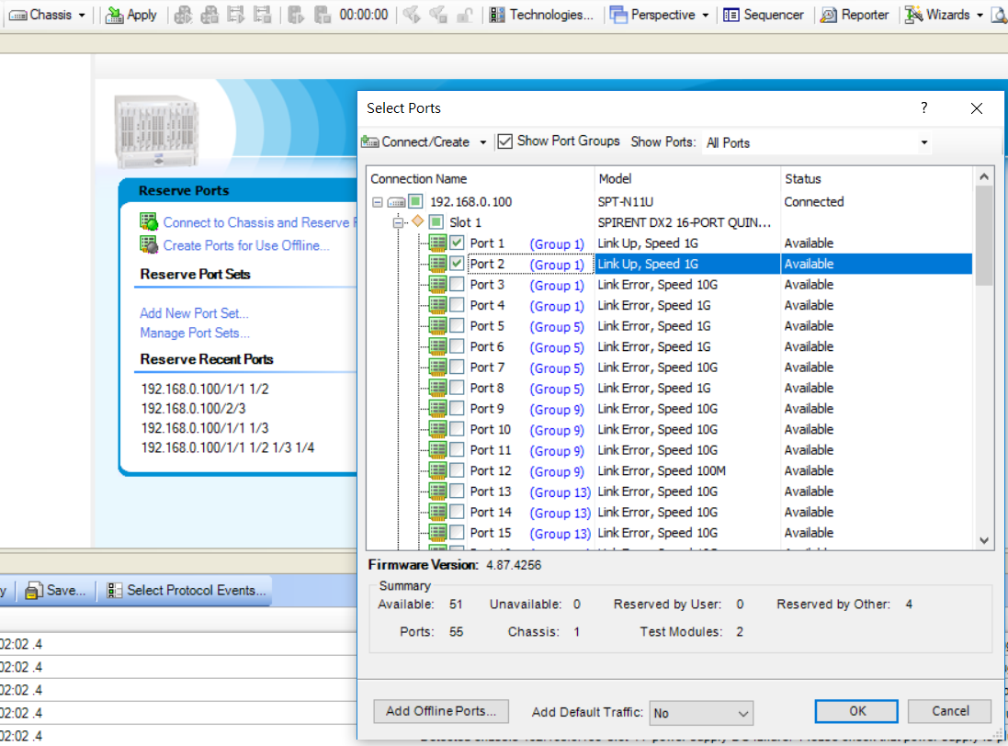
Select Ports
This are the ports you plugin the wire.

Slide 5
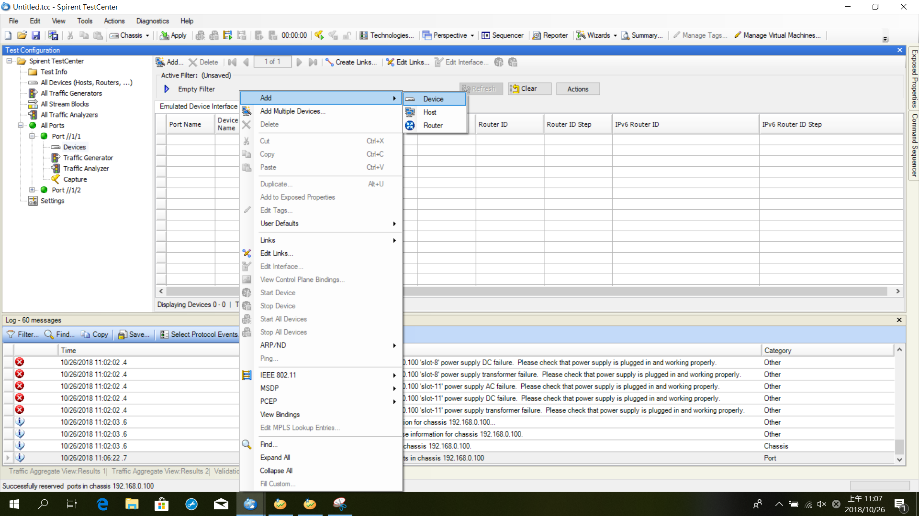
Add Port Device

Slide 6
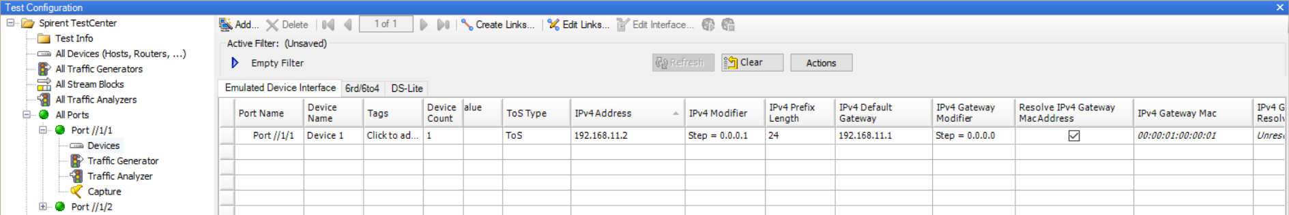
After Port Is Added
AMD Board Port IP
Spirent Test Center Side Port1 IP

Slide 7
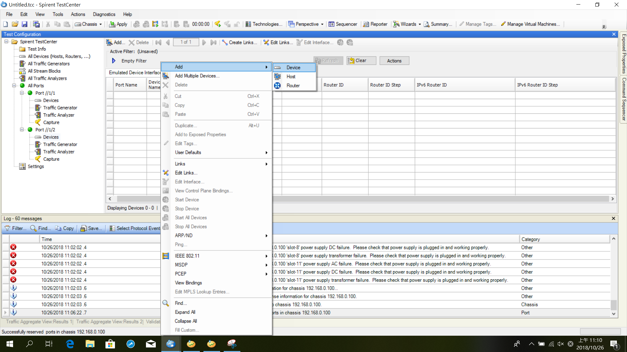
Add Another Port

Slide 8
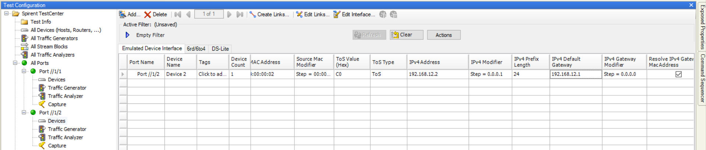
After Another Port Is Added
AMD Board Port IP
Spirent Test Center Side Port2 IP

Slide 9
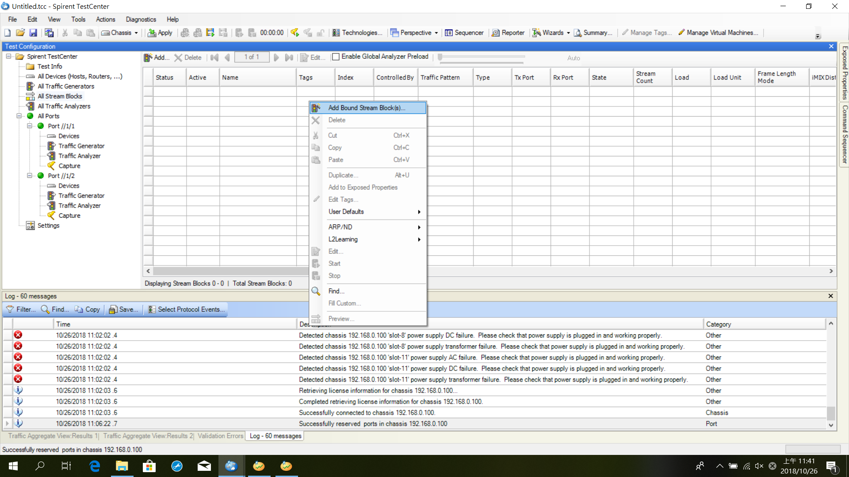
Setup Connection

Slide 10
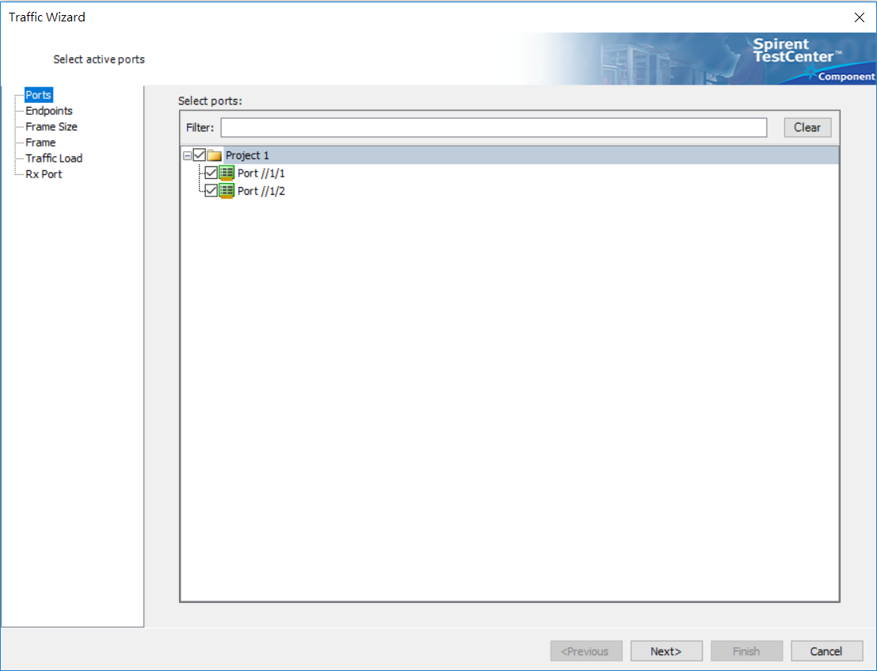
Check Two Added Ports

Slide 11
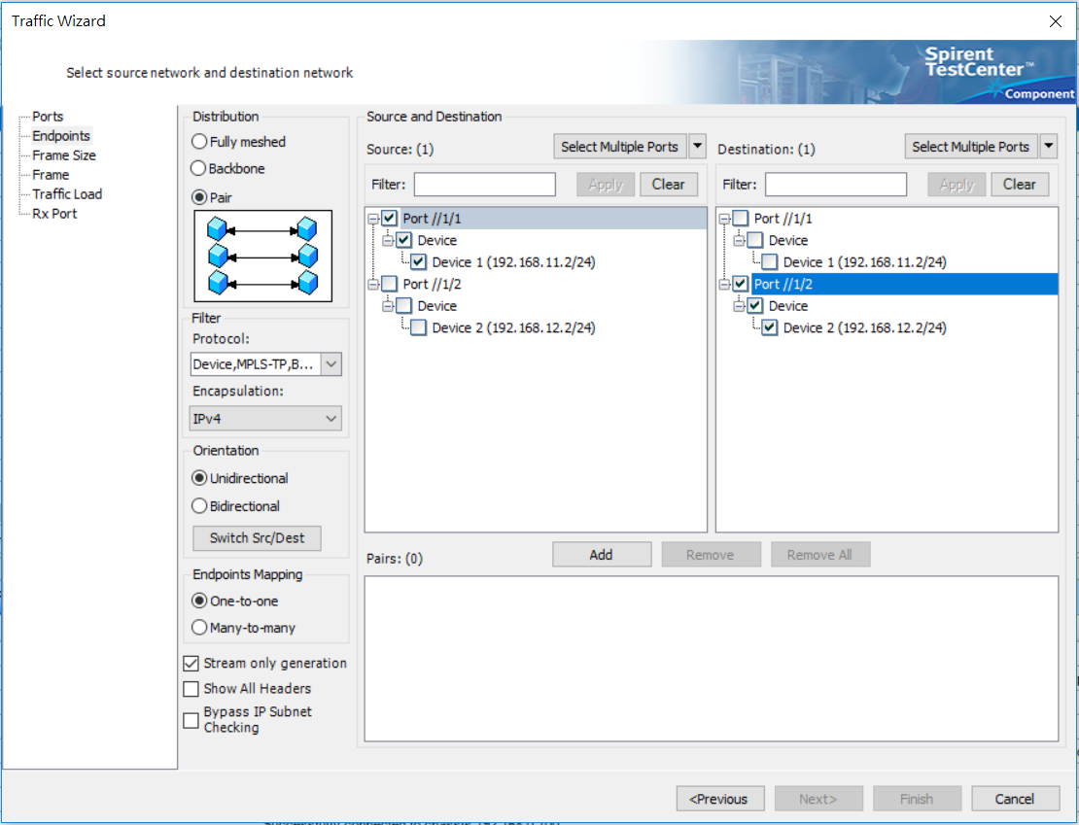
Set Source And Destination

Slide 12
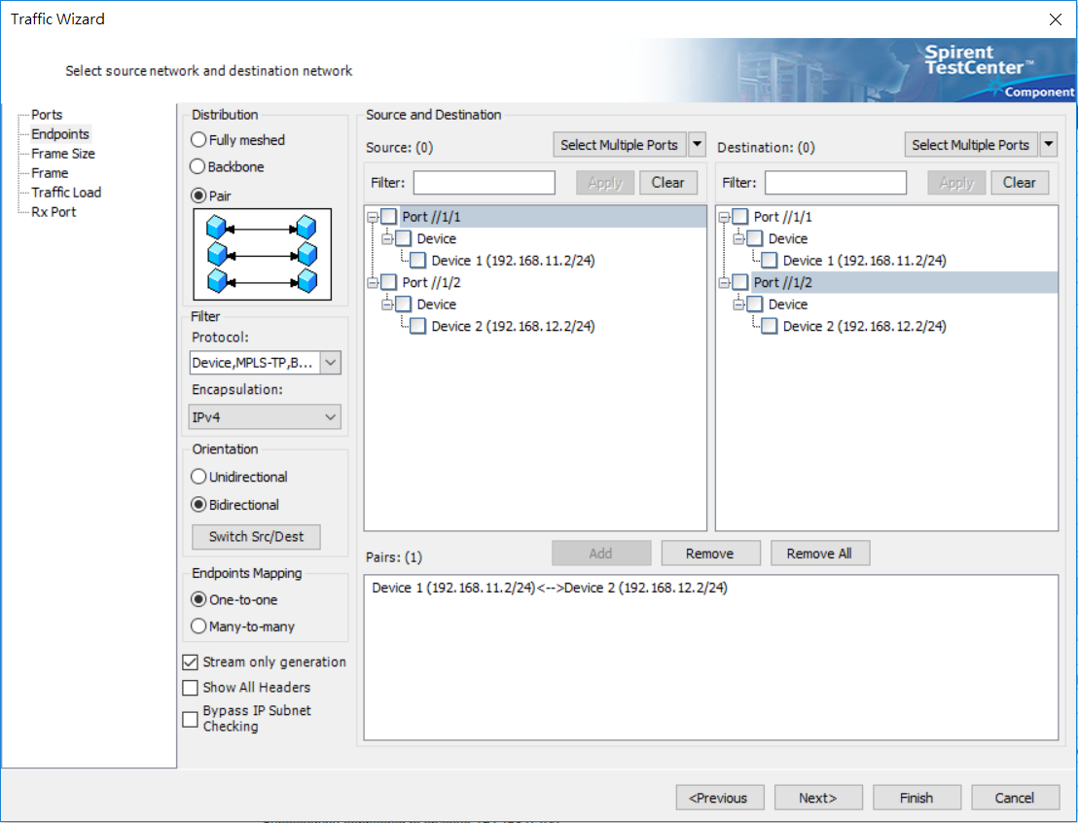
Add the Setting

Slide 13
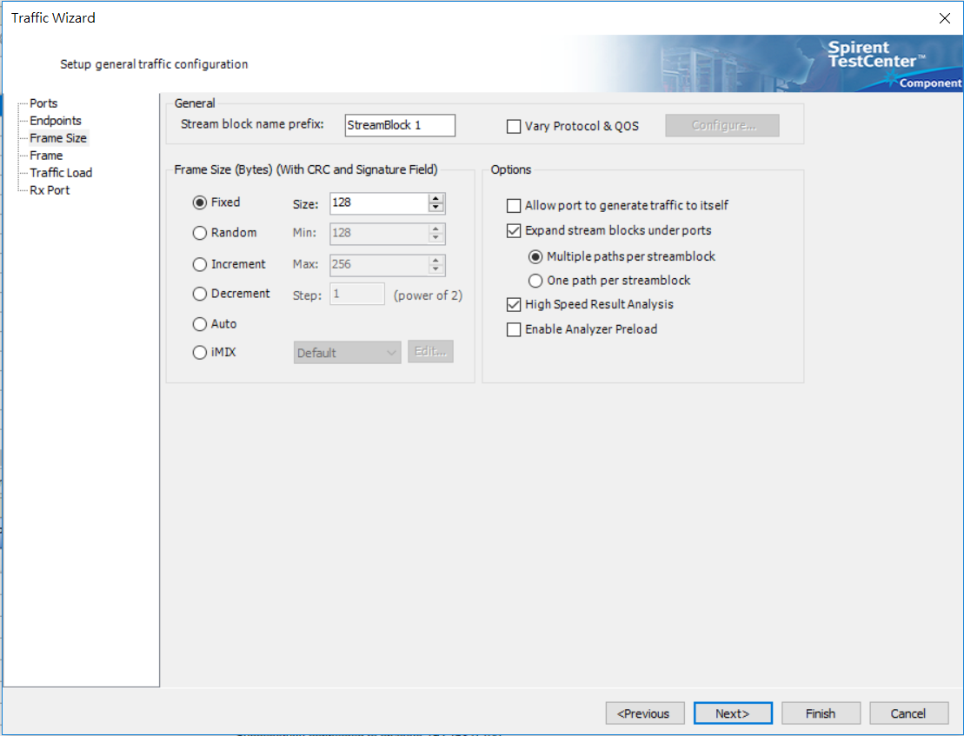
Click Next

Slide 14
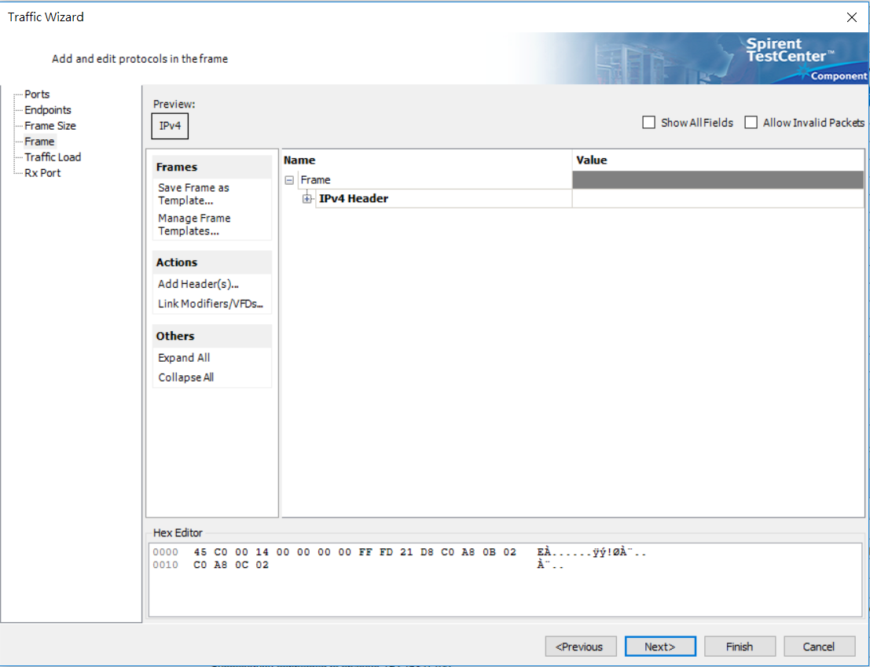
Click Next

Slide 15
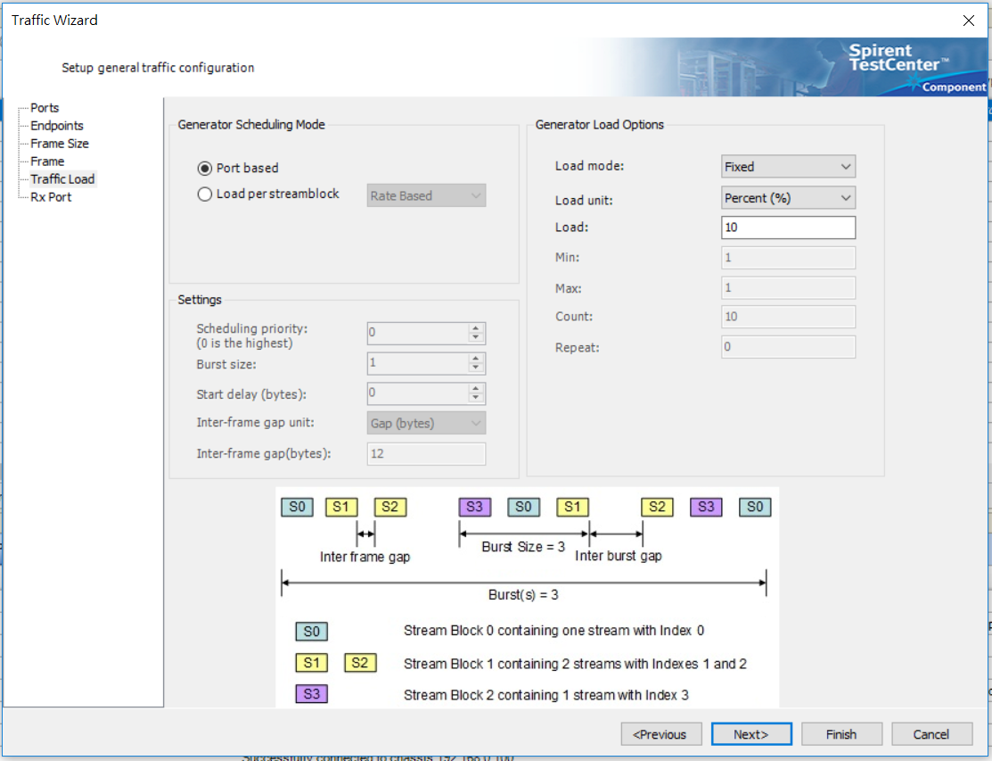
Click Next

Slide 16
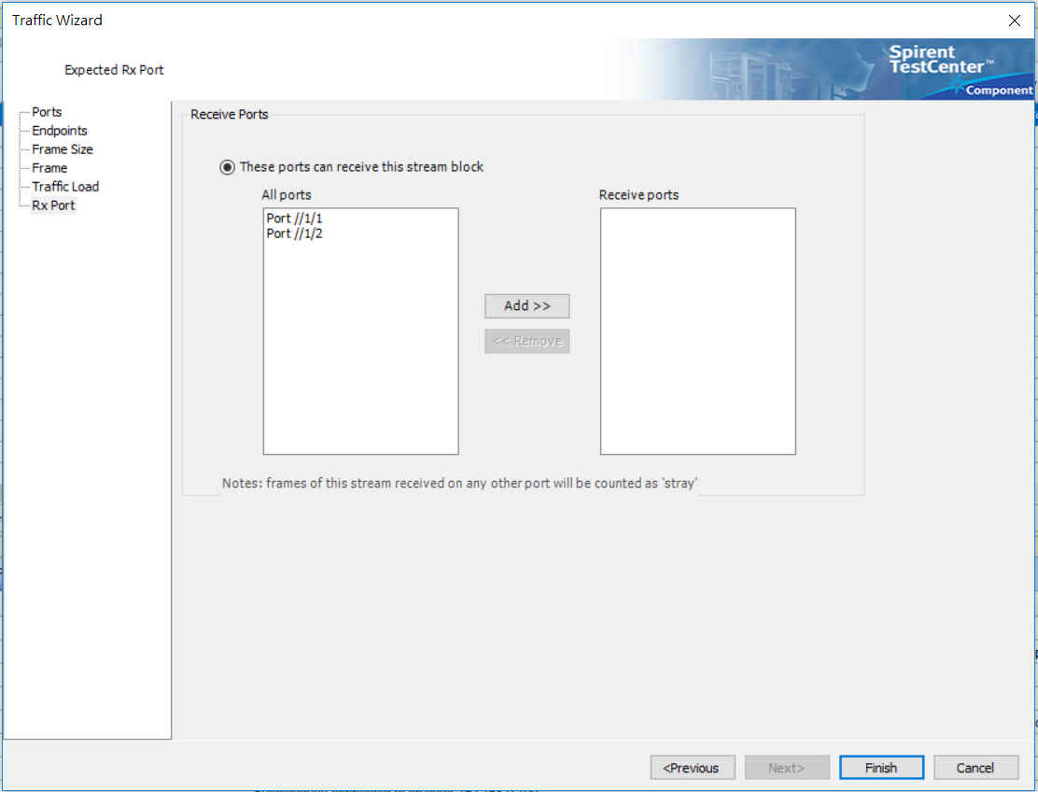
Click Finish

Slide 17
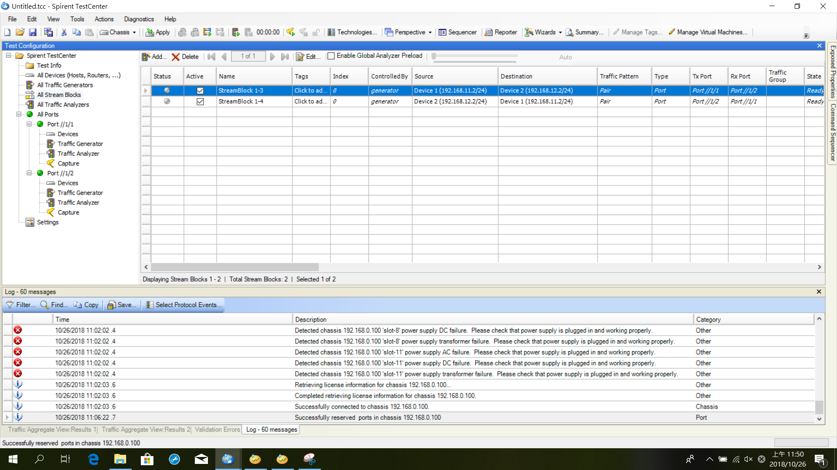
After Connection Set

Slide 18
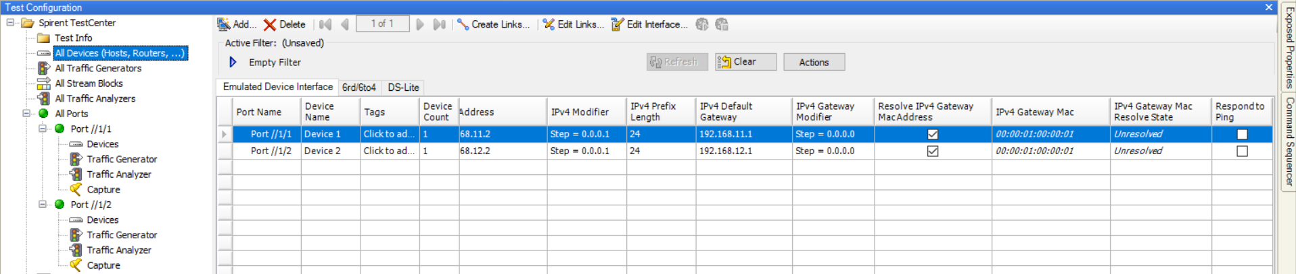
Select All Device on Side Bar

Slide 19
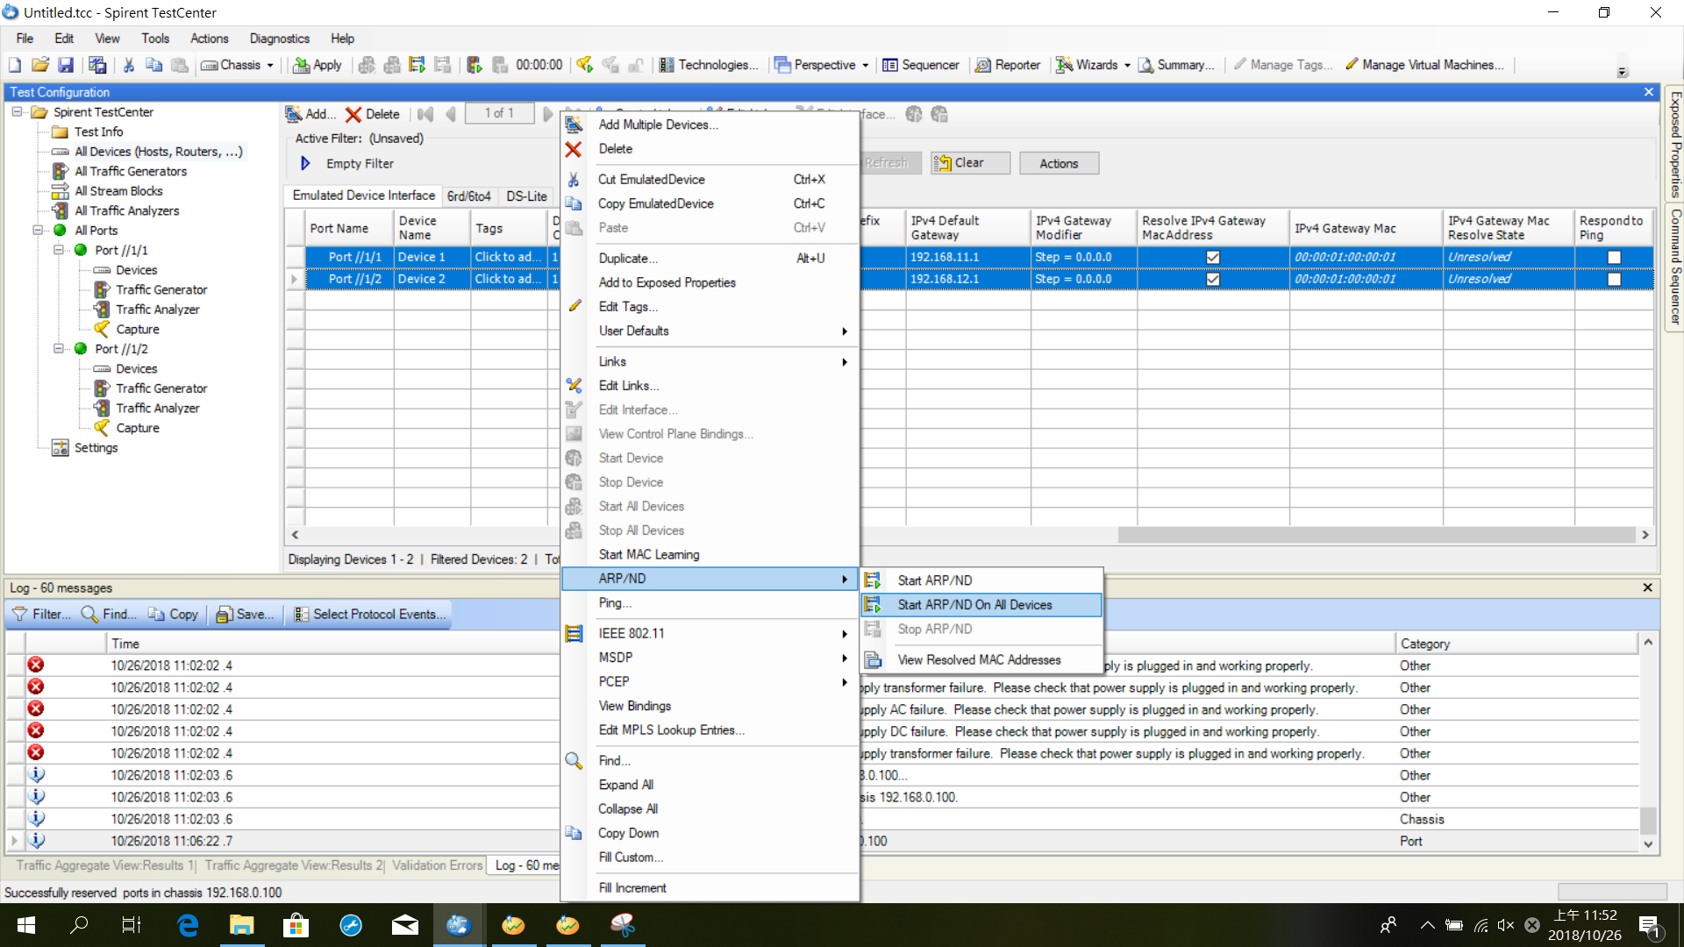
Start ARP to Check Status
Unresolved

Slide 20
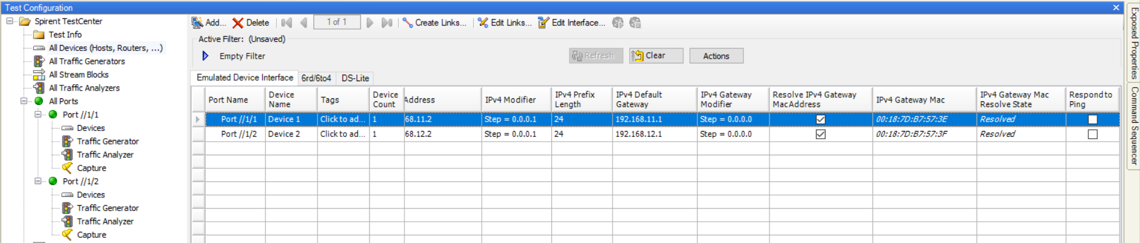
After ARP
Mac Address of Ports on AMD Board

Slide 21
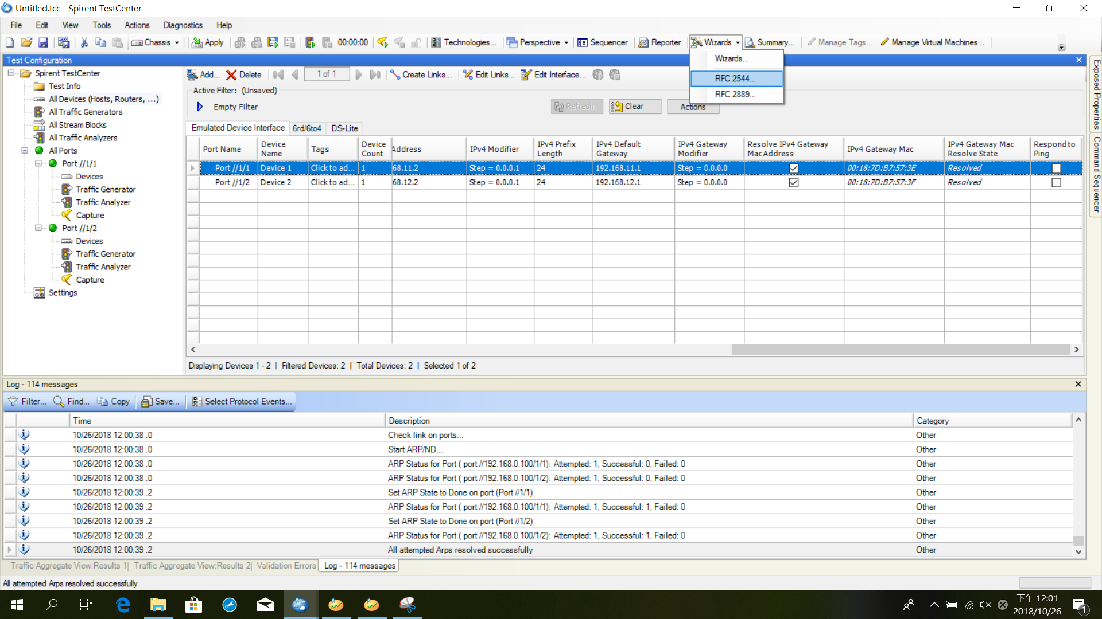
Setup the Test

Slide 22
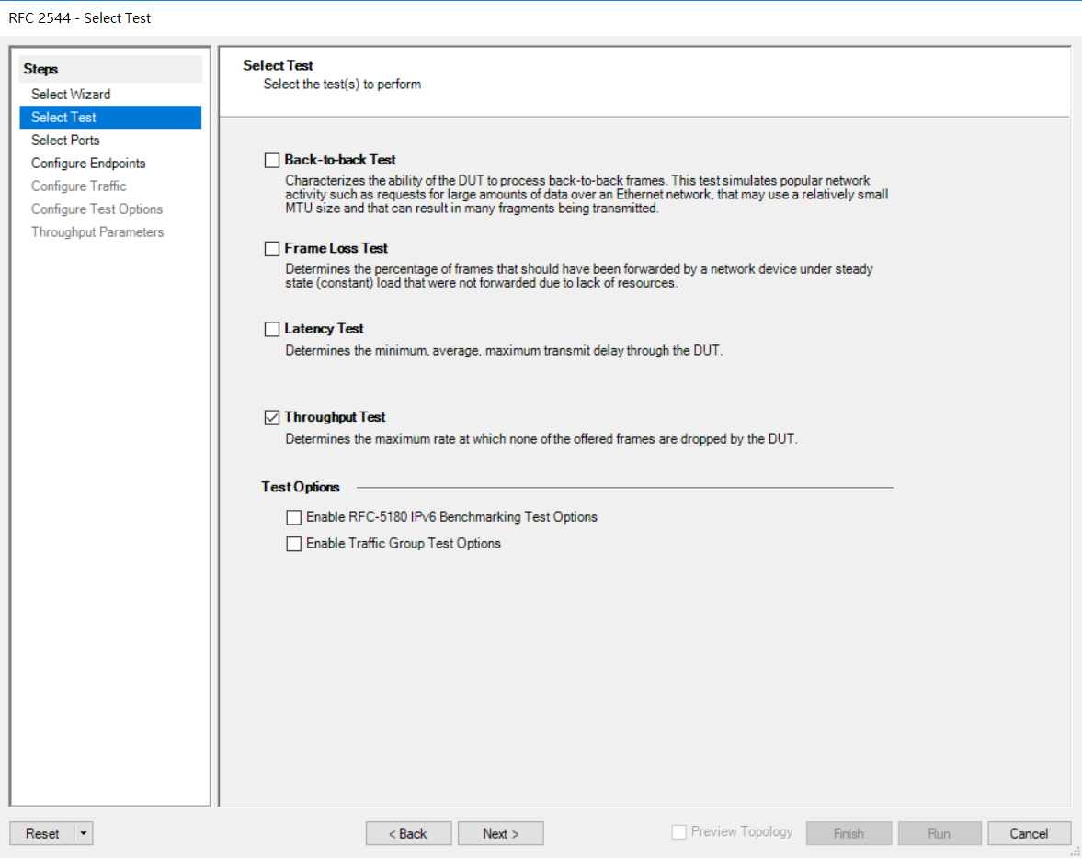
Select Throughput Test

Slide 23
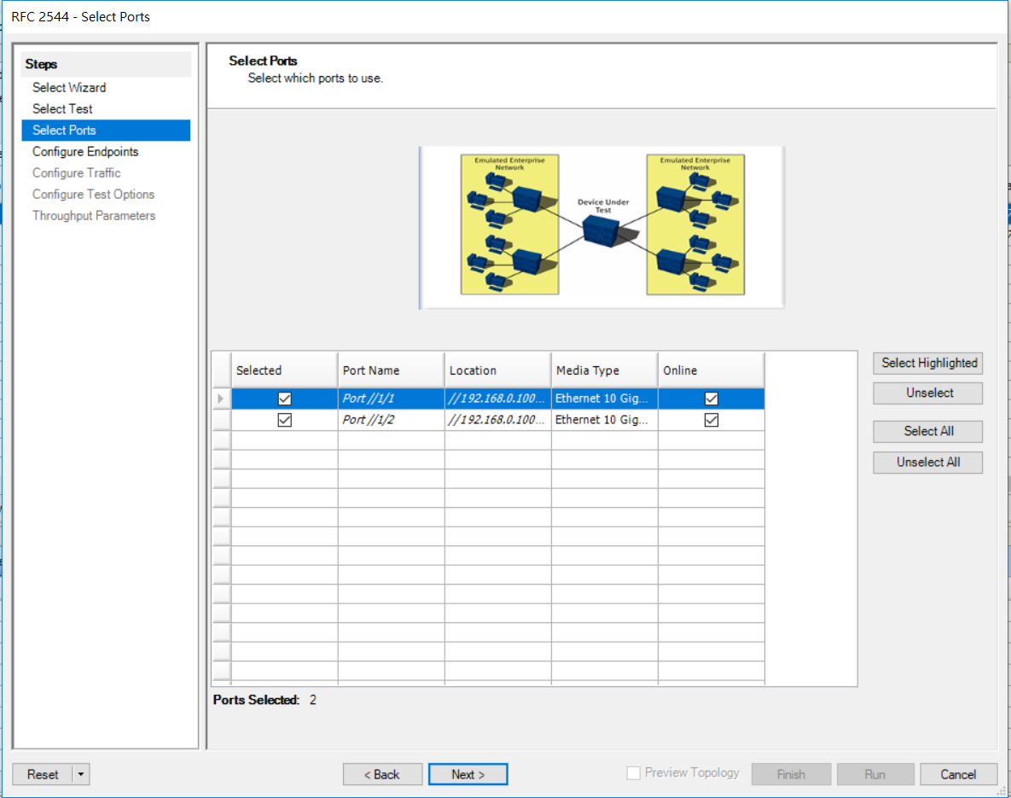
Select the Test Ports

Slide 24
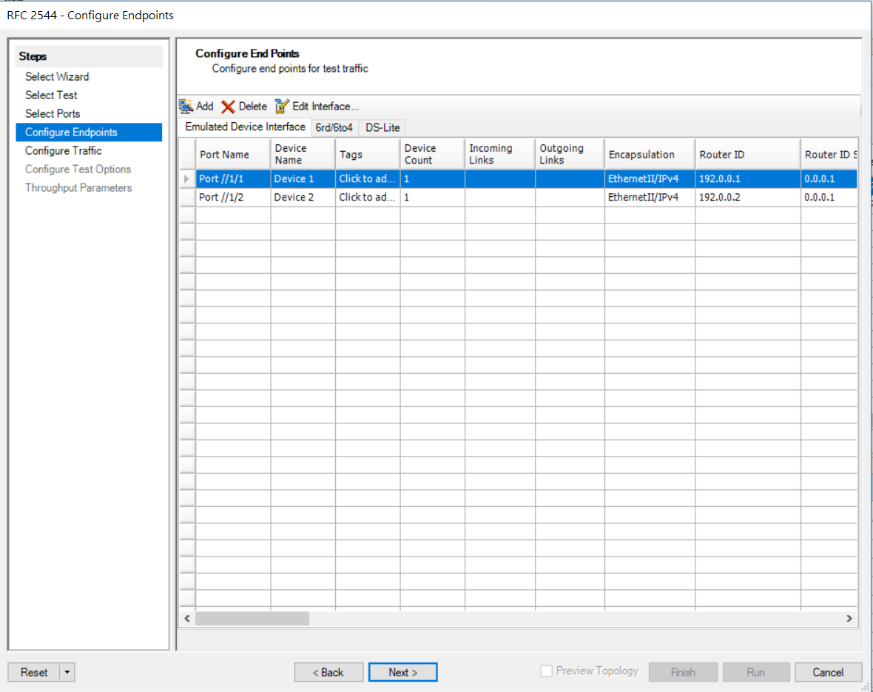
Click Next

Slide 25
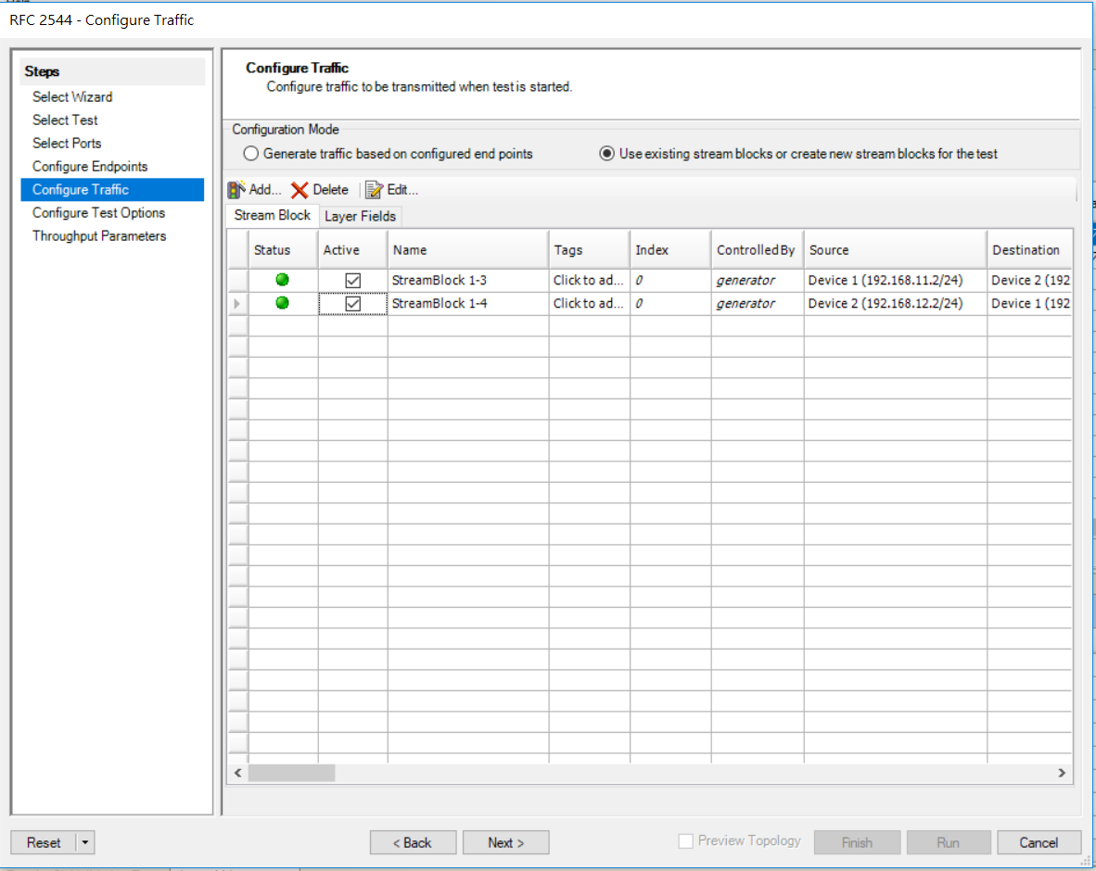
Click Next

Slide 26
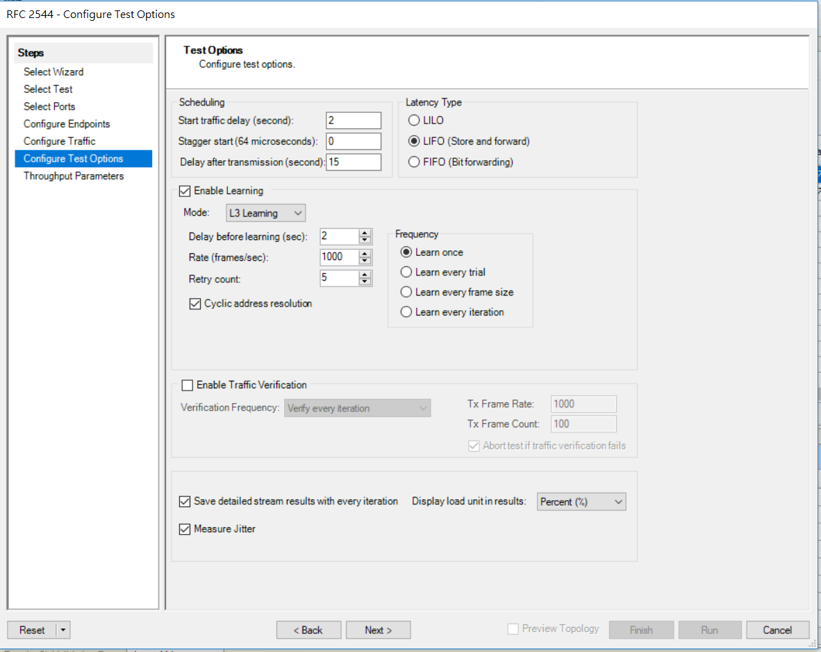
Configure Test Options

Slide 27
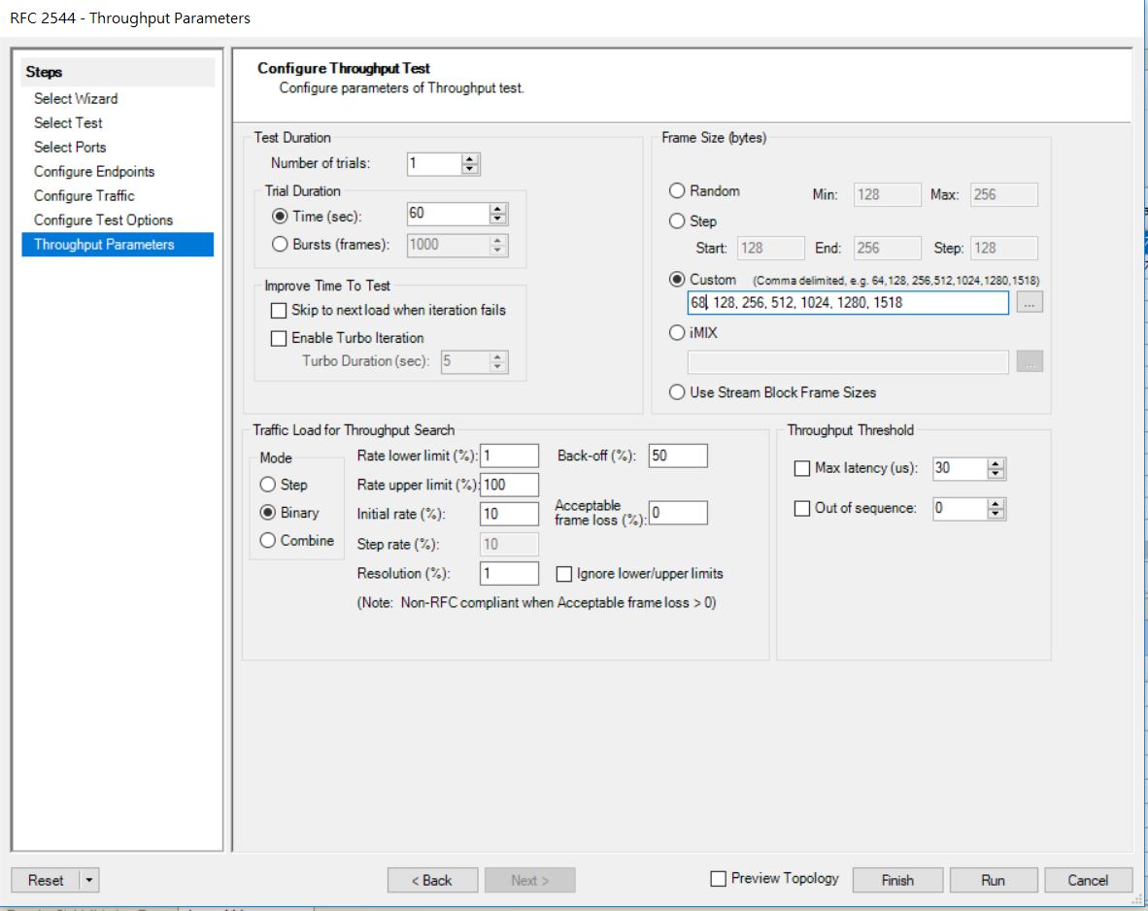
Throughput Parameters
Set to 68

Slide 28
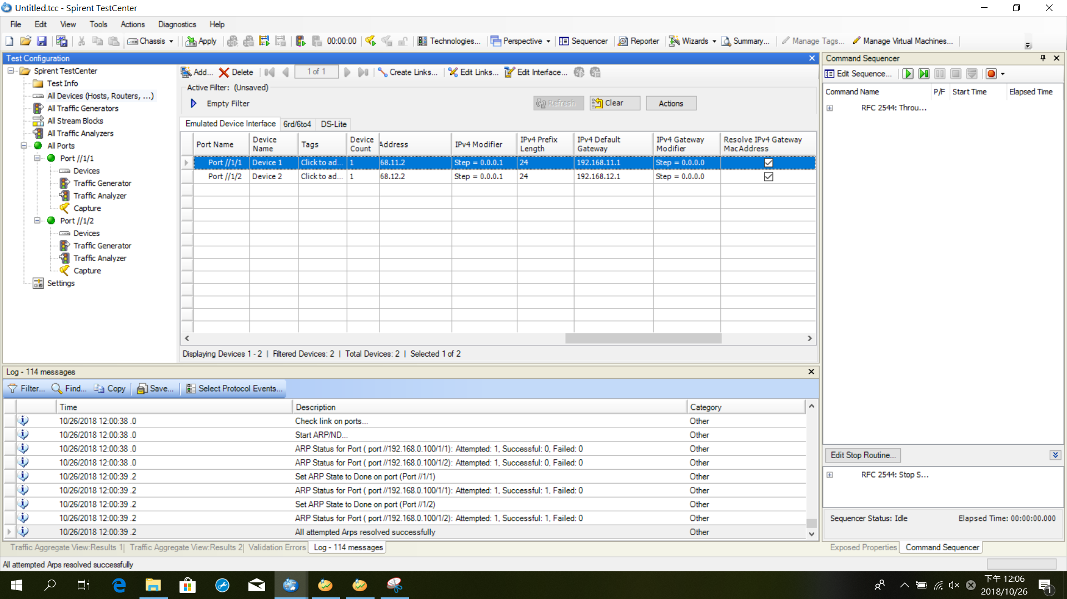
Click Run

Slide 29
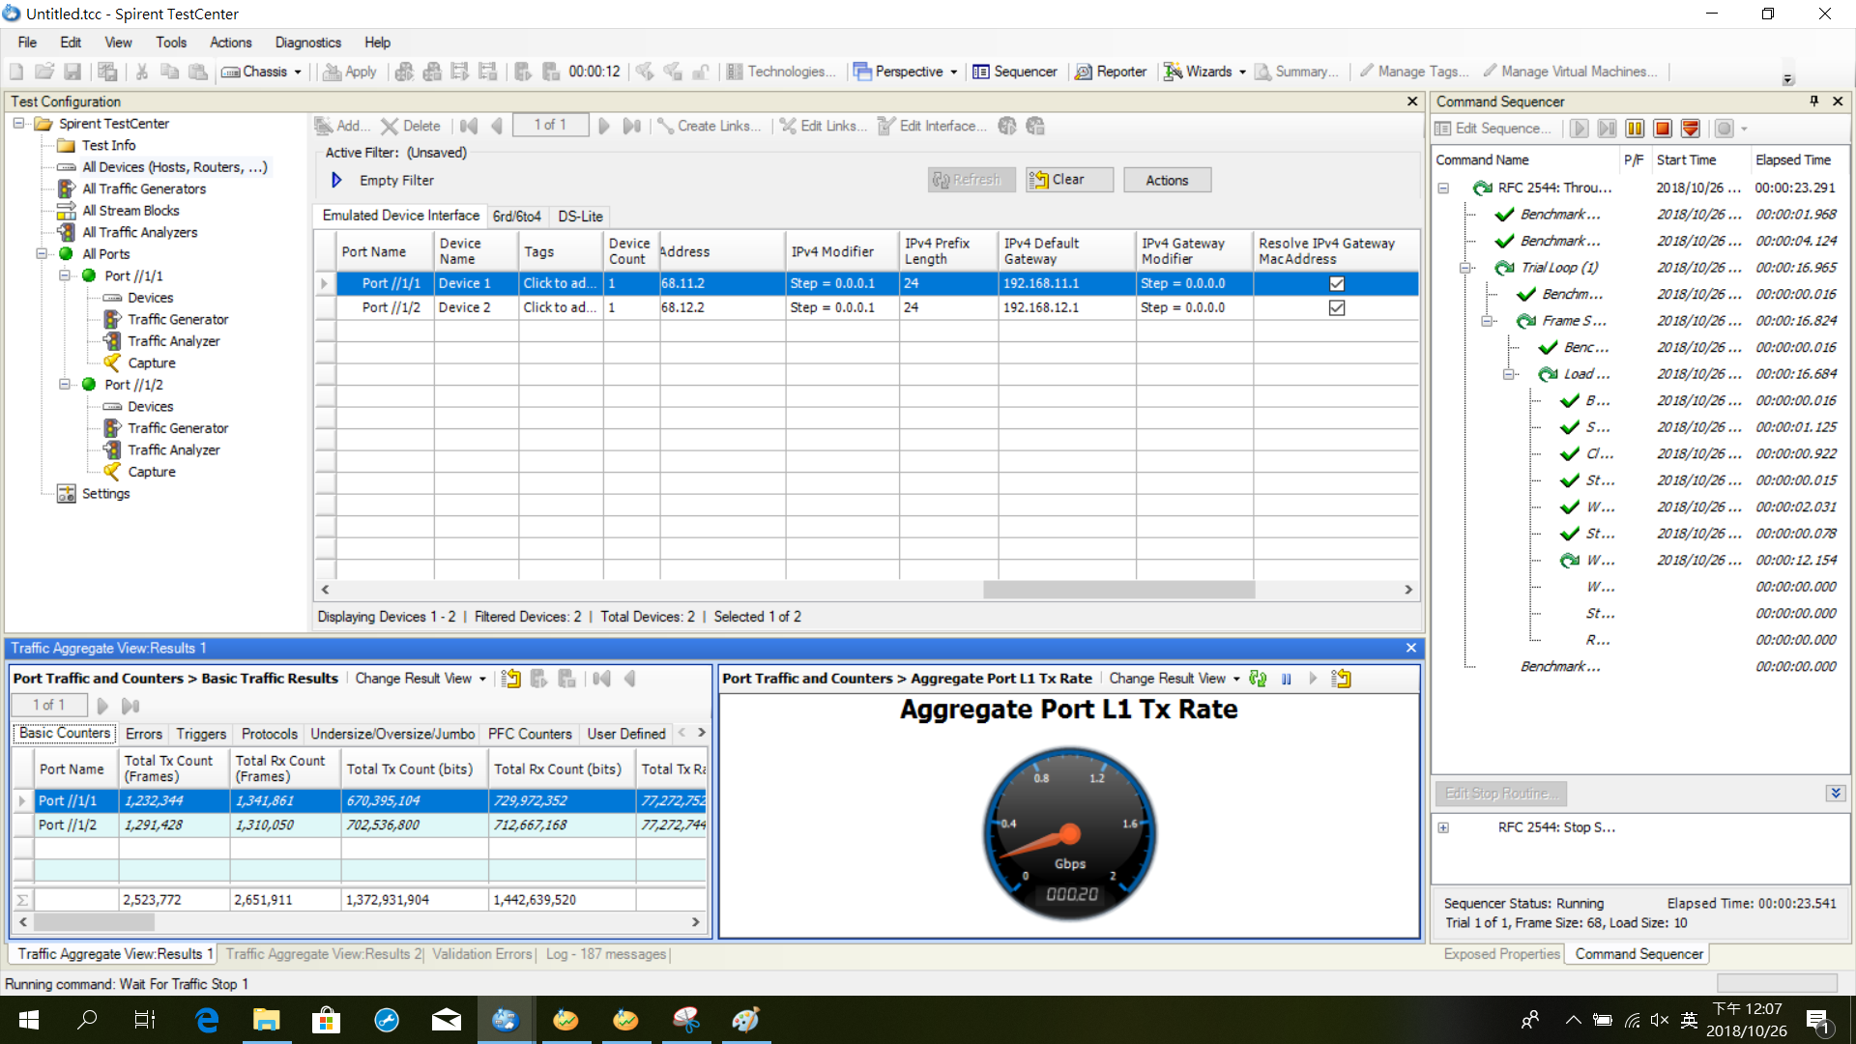
Start Running

